Slide 1
DC Motor
Presented By-
Omkar Savant-43
FYCM

Slide 2
Introduction
DC stands for Direct Current.
It does not changes its value as well as direction (polarity) with respect to time.
The DC machines are of two types namely DC generators and DC motors.
A DC generator converts mechanical energy into electrical energy
Whereas a DC motor coverts the electrical energy into mechanical energy.

Slide 3
DC Machines
DC machines are basically of two types :
D.C. generator
D.C. motor
A dc generator is rotated by a prime mover and produce a dc voltage. So it convert mechanical energy into electrical energy.
A dc motor receives energy from dc voltage source and rotates at a speed proportional to the applied voltage. So a dc motor converts the electrical energy into a mechanical energy.

Slide 4
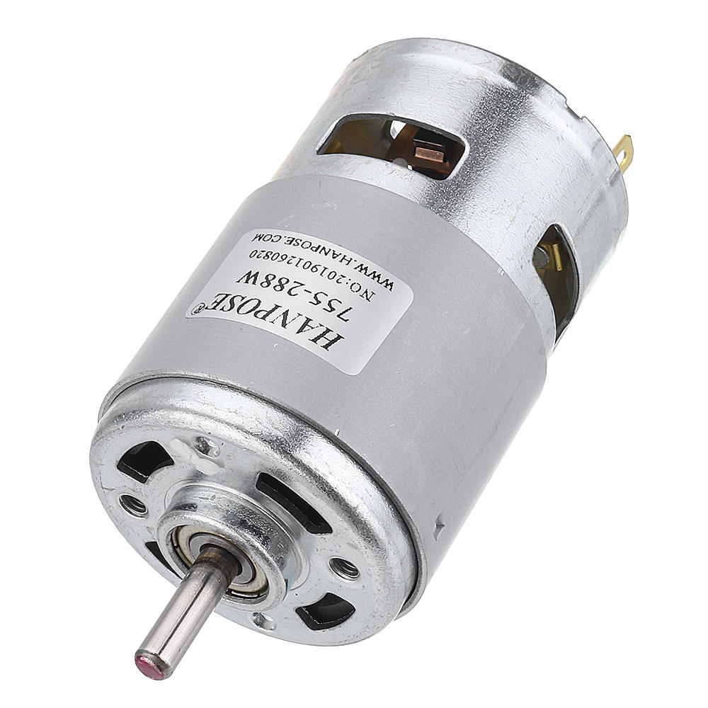
Fig.1. D.C. Motor

Slide 5
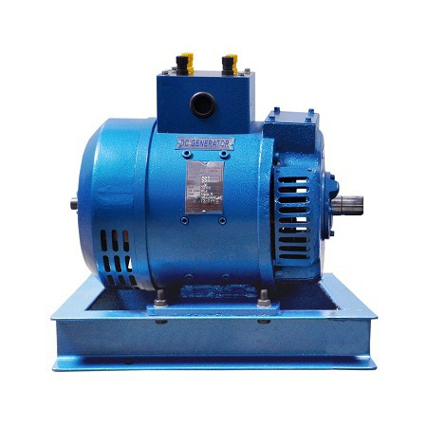
Fig.2. D.C. Generator

Slide 6
Windings in a DC machine
In any dc machine, there are two windings:
Field Winding
Armature Winding
Out of these, the field winding is stationary which does not move at all and the armature winding is a movable winding.
The construction of the a dc motor and generator is the same. That means we can us the same dc machine either as generator or as a motor.

Slide 7
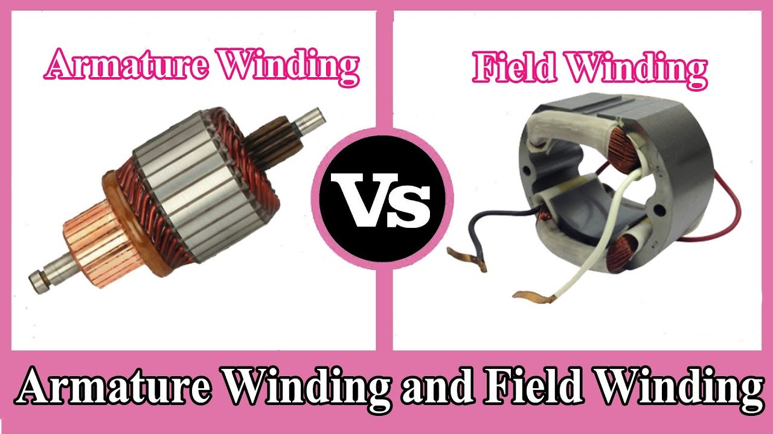
Fig.3. Armature and Field Winding

Slide 8
Principle of Operation of a DC motor
When a current carrying conductor is placed in a magnetic field, it experiences a force.
The armature winding is connected to an external dc source, hence it plays the role of the current carrying conductor placed in the magnetic field.
Due to the force exerted on it when placed in the magnetic field, it starts rotating and the armature starts rotating.
The direction of rotation depends on the direction of the magnetic field produced by the field winding as well as the direction of magnetic field produced by the armature.

Slide 9
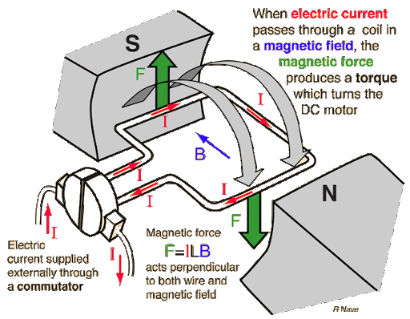
Fig.4. Principle of DC motor

Slide 10
Important Parts of a DC machine
The important parts of DC machine are as follows:
Yoke
Field Winding
Poles
Armature
Commutator, brushes and gear.
Bearings

Slide 11
Types of Armature Winding
Depending on the manner of connecting the conductors, the armature winding in classified into two types:
Armature Winding
Lap winding Wave winding

Slide 12
Types of DC motors
Depending on the way of connecting the armature and the field winding of a d.c. motor, the d.c. motor are classified as follows:
DC series motor
DC shunt motor
Compound motors
The compound motor is further classified as short shunt compound and long shunt compound motors.
Compound Motor
Short shunt compound Long shunt compound

Slide 13
DC Shunt Motor
In the D.C shunt type motor, the armature and the field winding are connected in parallel. The parallel combination of the two winding is connected across the a common dc supply.
The resistance of the shunt field winding (R_{SH} ) is always much higher than that of armature winding (R_{a}).
The flux produced remains constant, because field current is responsible for generation of flux.
∴ φ ∝ I_{sh}
Shunt motor is also called constant flux motor.

Slide 14
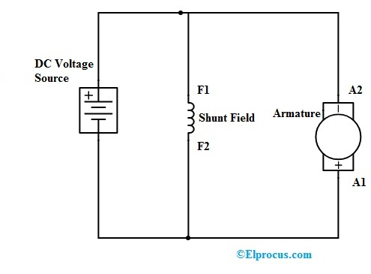
Fig.5. DC Shunt Motor- Circuit Diagram

Slide 15
DC Series Motor
In the D.C. series motor, the armature and field windings are connected in series with each other.
The resistance of the series field winding (R_{s}) is much smaller as compared to that of armature resistance (R_{a}).
The flux produced is proportional to field current.
∴ φ ∝ I_{a}

Slide 16
Since the armature current flows through the series field winding, the flux is proportional to the field current I_{s} as well.
∴φ ∝ I_{s}
In dc series motor the flux φ does not remain constant.
So the DC series motor is not a constant flux motor.

Slide 17
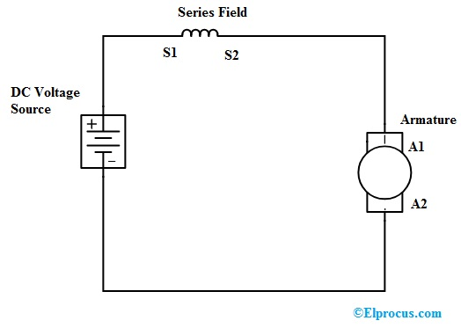
Fig.6. DC Series – Circuit Diagram

Slide 18
DC compound Motor
The DC compound motors are classified into two types:
Long Shunt
Short Shunt
In compound motors, a part of the field winding is connected across the armature and the remaining field winding is connected in series with the armature.
Long and short shunt are further classified into two subclasses namely the cumulative compound motor and differential compound motor.

Slide 19
Long Shunt Compound Motor
The Long shunt field winding is connected across the series combination of the armature and series field winding
The mechanical load is coupled to the shaft of the motor.
The Resistances of various windings are as follows:
Armature winding : R_{a}
Series field winding : R_{se}
Shunt field winding : R_{sh}

Slide 20
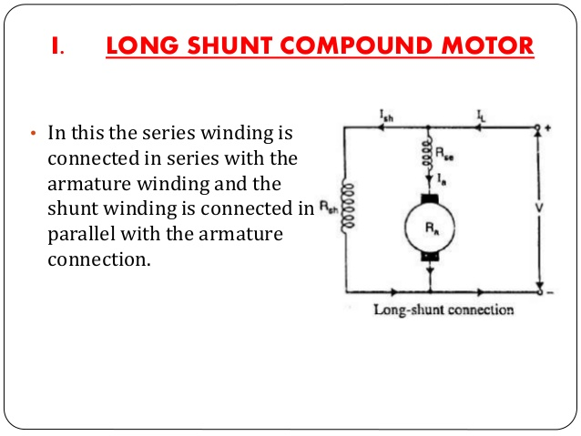
Fig.7. Long Shunt DC Motor

Slide 21
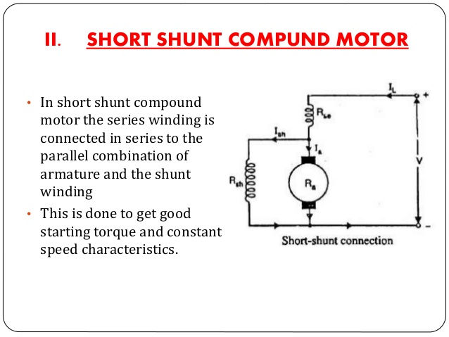
Short Shunt Compound Motor
The armature and shunt field windings are connected in parallel combination is then connected in series with the series fields windings.
Fig.8. Short Shunt DC motor

Slide 22
Applications
Various machine tools such as drilling machine, milling machine, etc.,
Electric train
Elevator
Printing machine
Cranes
Rolling mills
Paper Machines
Trolley Cars and trolley Buses

Slide 23
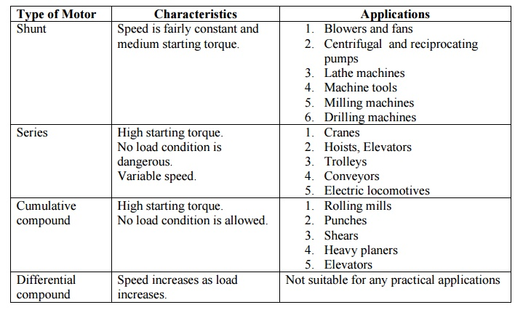
Fig.9. Applications of DC motor

Slide 24
Conclusion
DC machines are of two types: DC motor and DC Generator
DC generator converts mechanical energy into electrical energy
DC motor coverts electrical energy into mechanical energy.
The motors described above are used in industry for various applications. Which type of motor will suit a particular load depends on the requirement of load and the characteristics exhibited by the motor. These motor can be used for various purpose.
DC motor are indeed a one of the greatest invention of Human kind.

Slide 25
Thank You

